Slide 1



Studemt management system
[WORK REPORT]
Team:Nameless Team
Member：车猛（CheMeng）,陈鹏（ChenPeng）,赖汕（LaiShan）,杨钰铭（YangYuming）.

Slide 2
目录
CONTENTS
01
introduction
02
Appreciation of works
03
Feel after doing

Slide 3
1
introduction
作品简介

Slide 4
more easy
The six interfaces are:
login interface, welcome interface, query interface, exit interface, new user creation interface.
Because we are students, we thought of a program that would make it easier for students to log in to the system to query information.
This makes life easier for students
First, we designed six interfaces to take on different tasks.
fast
simple
fast

Slide 5

0
Management system
Students are the hope of the country, and caring for students is to defend the country. This has to make students benefit more, and students need to pay their own creativity and full of blood.

Slide 6
This is the only way to end the program and is a sign of the completion of the program.
Enable students to log in to the system with their own username and password.
It is the main function of this program and the soul of this program.
Is the first interface to guide students into the system
This is the main way of storing data for this program.tly.
exit .
login .
welcome.
Inquire.
new user.

Slide 7
2
Appreciation of works
作品鉴赏

Slide 8
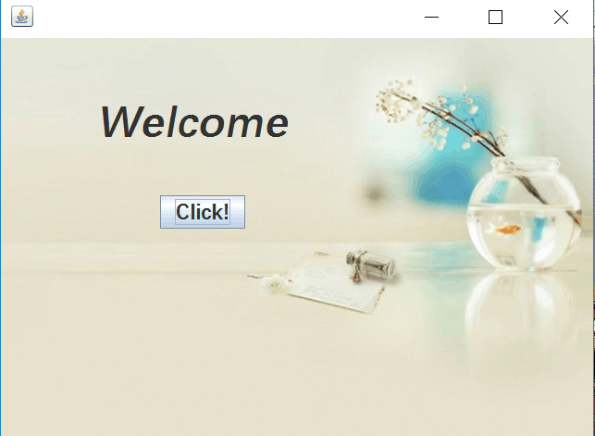

Slide 9
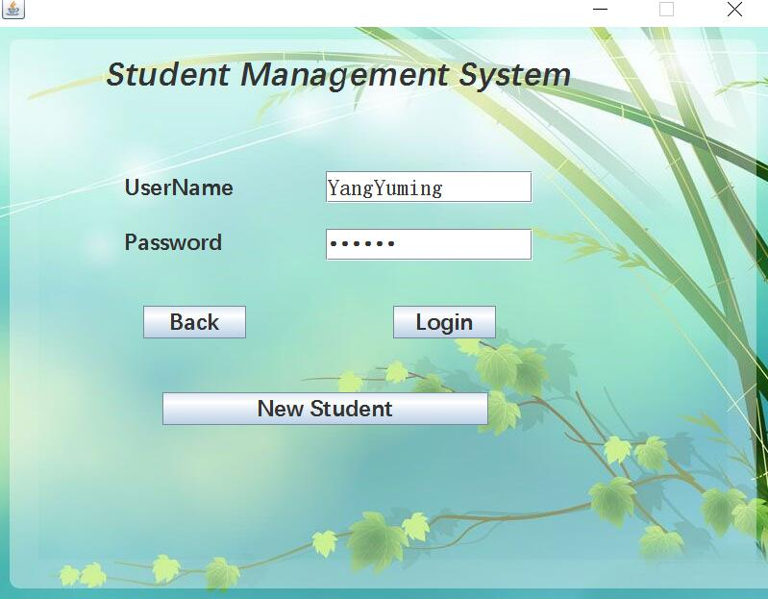

Slide 10
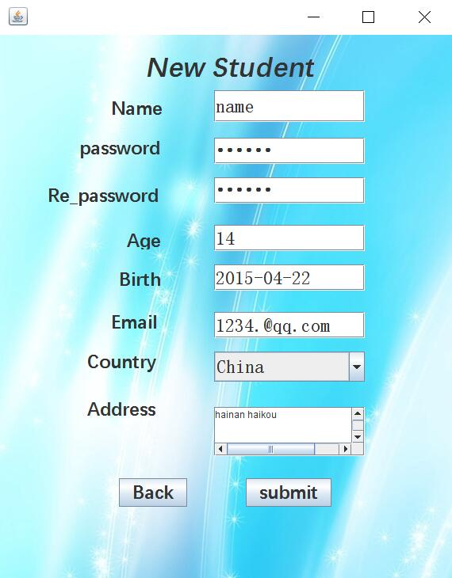

Slide 11
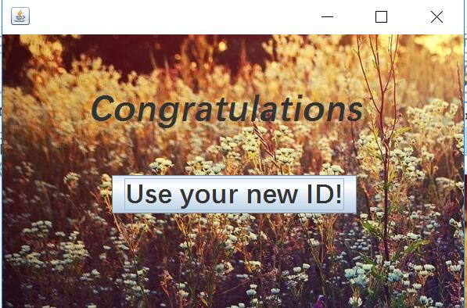

Slide 12
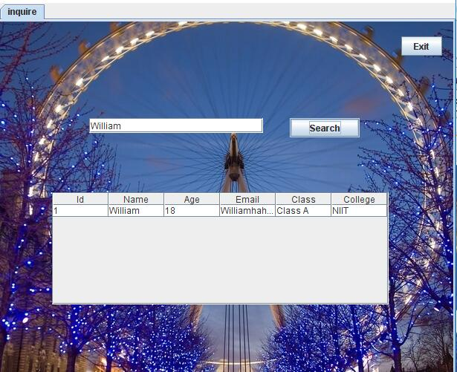

Slide 13
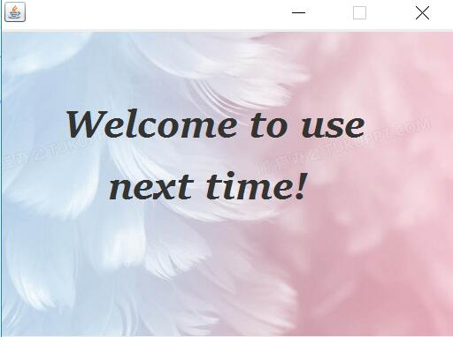

Slide 14
3
Feel after doing
.
做后感想

Slide 15
As long as you work hard, you will increase your chances of success.
Although the program is small, it takes a lot of energy.
There are many people working hard behind every program.
Thanks to those who have struggled for our happiness.
Strive for your own life

Slide 16
Successful approach
So reciprocating
Arrival victory
y.
Work harder to achieve it
y.
Re-establish a larger goal
First establish a small goal
Strive to achieve it

Slide 17
Thanks for listening, criticism, guidance
感谢聆听 批评指导
THANK YOU

